Slide 1

运用科研工具开拓视野，展示科研能力，发表高水平科研成果
刘晓倩 博士
Liu, (Sarah) Xiaoqian Ph.D
Customer Consultant
x.liu.2@elsevier.com
励德爱思唯尔信息技术（北京）有限公司
Reed Elsevier Information Technology (Beijing) Co., Ltd
2019 April

Slide 2

Elsevier及其出版內容
青海大学大学科研产出分析及Elsevier相关优质出版内容推荐
Scopus + ScienceDirect平台帮助青海大大学研究人员快速定位所需内容
科研论文发表导论

Slide 3
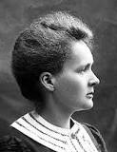
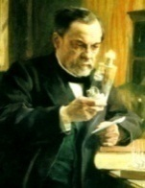
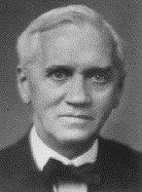


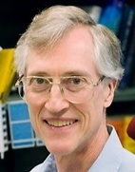


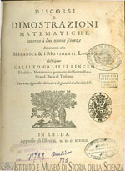
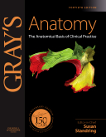


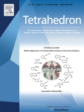
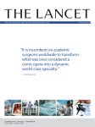




Elsevier在科学，技术和健康方面声誉卓越
Marie Curie
(Physics, Chemistry)
Louis
Pasteur
(Chemistry)
Alexander Fleming
(Medicine)
Albert Einstein (Physics)
Shinya
Yamanaka
(Medicine)
John C. Mather (Physics)
Francoise
Barre-Sinoussi
(Medicine)
Craig C Mello (Medicine)
Galileo’s last and greatest work, published in 1638 by Elzevir, Discorsi e Dimostrazioni Matematiche
Notes:
Our customers are doing momentous things, and we are uniquely positioned to show our customers the ‘art of the possible’.
For more than 130 years we have shared their commitment to transforming and advancing science, health and technology. We understand the worlds in which clinicians, educators, and academic and corporate researchers work, the outcomes they want to achieve and the challenges they face in achieving them. (Pictures are some of the Nobel Laureates publishing in our journals).
We have a responsibility to use that understanding to create highly effective solutions that enable our customers to leverage the vast potential of information to advance science, health and technology in ways that they could not do alone, and to anticipate the new ways customers will want to use information in the future. That is what we mean by ‘leading the way’.

Slide 4
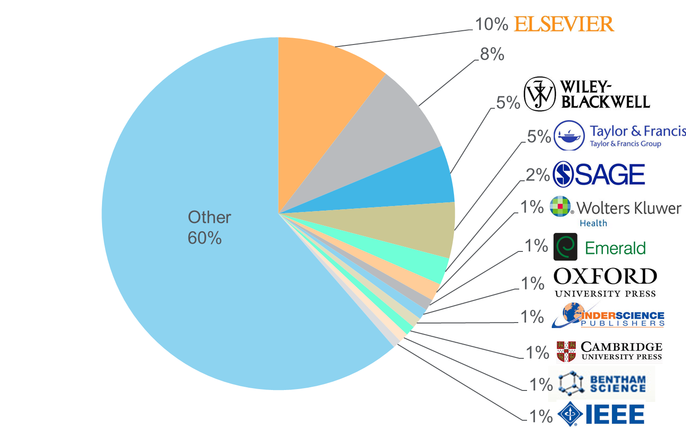

Elsevier是世界最大科技出版社
Source: November 2015 title list at https://www.elsevier.com/solutions/scopus/content
Notes:
Publisher neutral

Slide 5
ScienceDirect的期刊内容不断增长
Elsevier Published Articles (‘000)
419
436
380
400
365
321
336
284
295
297
258
267
+5% CAGR
2006
2007
2008
2009
2010
2011
2012
2013
2014
2015
2016
2017

Slide 6
Our journals are ranking highly in every field
Journal ranking—Citescore
Journal ranking—Impact Factor
Share of top–10% journals
Subjects with top rank
(All Science Journal Classification)
Share of top–10% journals
Subjects with top rank
(Journal Citation Reports)
107
29%
75
32%
14%
12%
34
13%
15%
27
27
30
3%
10
3%
10
Elsevier
Company A
Company B
Company C
Elsevier
Company A
Company B
Company C
Elsevier
Company A
Company B
Company C
Elsevier
Company A
Company B
Company C
Journal ranking by CiteScore across 330 subjects per Scopus Metrics database; source: Scopus data (2016)
Journal ranking by Journal Impact Factor across 234 subjects per Clarivate’s Journal Citation Reports database; source: Clarivate data (2016)

Slide 7
Elsevier及其出版內容
青海大学大学生态学学科科研产出分析及Elsevier相关优质出版内容推荐
Scopus + ScienceDirect平台帮助青海大大学研究人员快速定位所需内容
科研论文发表导论

Slide 8
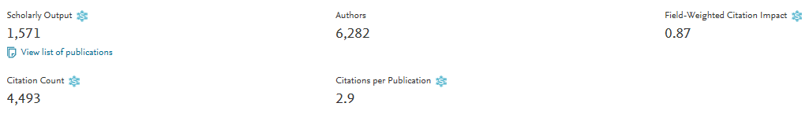
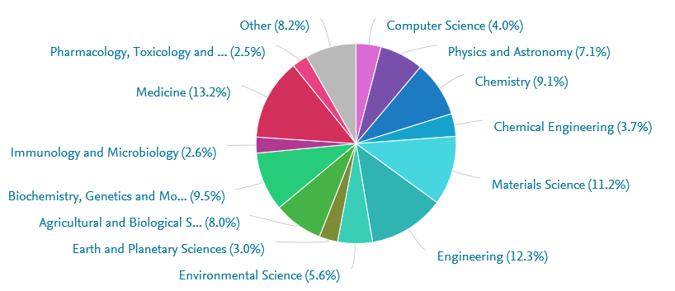
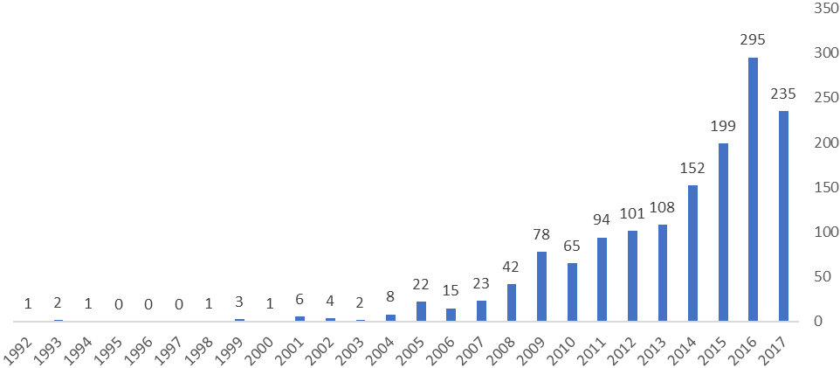
青海大学科研现况分析
青海大学自1992年以来，共发表文献1,028篇，被引2,062次。
青海大学研究人员发文最多的邻域是医学、工程学、材料科学

Slide 9
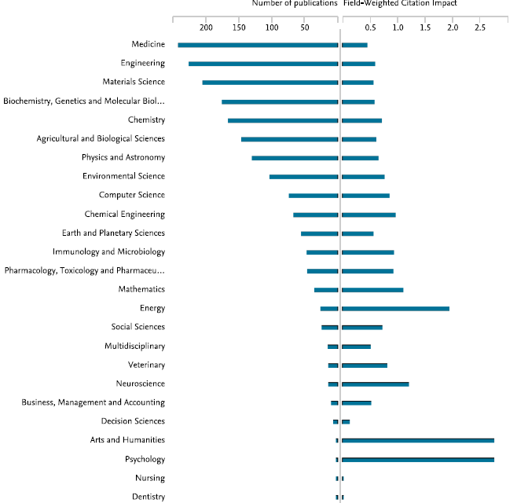
青海大学重点学科发展现况
Tab. 青海大学重点学科及学科发展现况
“双一流学科”：生态学
青海大学优势学科(FWCI>1)为5个（右图）：能源学、神经科学、艺术与人文和心理学、数学，但发文量均低于50篇。
青海大学主要发展重点学科9个，覆盖7个Elsevier学科，其中感染病学、细胞生物学研究能力突出，FWCI超过世界平均水平1，其余学科FWCI<1
上述结果说明重点学科及优势学科发展均需进一步支持
Fig. 青海大学发文量VS.FWCI
Data source：Scopus data 2013-2017

Slide 10
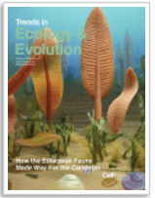
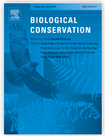
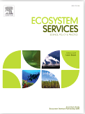
生态学优质期刊推荐
Trends in Ecology & Evolution
Trends in Ecology & Evolution (TREE) contains polished, concise and readable reviews, opinions and letters in all areas of ecology and evolutionary science. It serves as an invaluable source of information for researchers, lecturers, teachers, field workers and students. Trends in Ecology & Evolution keeps these scientists informed of new developments and ideas across the full range of ecology and evolutionary biology - from the pure to the applied, and from molecular to global. Now, more than ever before, is it necessary for life scientists to be aware of research from a wide range of disciplines, especially in the face of the gathering momentum of global environmental change and destruction. More than any other journal, Trends in Ecology & Evolution is the major forum for coverage of all the important issues concerning organisms and their environments.
IF:15.938, Citescore: 10.35
Biological Conservation
Biological Conservation is a leading international journal in the discipline of conservation science. The journal publishes articles spanning a diverse range of fields that contribute to the biological, sociological, ethical and economic dimensions of conservation.
IF:4.66, Citescore: 4.63
Ecosystem Services
Ecosystem Services, associated with the Ecosystem Services Partnership (ESP), is an international, interdisciplinary journal that deals with the science, policy and practice of Ecosystem Services in the following disciplines: ecology and economics, institutions, planning and decision making, economic sectors such as agriculture, forestry and outdoor recreation, and all types of ecosystems.
IF:4.83, Citescore: 4.295

Slide 11
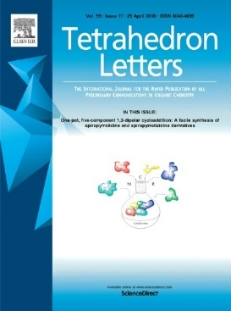
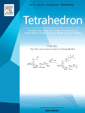
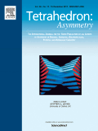
化学优质期刊推荐
Tetrahedron Letters provides maximum dissemination of outstanding developments in organic chemistry. The journal is published weekly and covers developments in techniques, structures, methods and conclusions in experimental and theoretical organic chemistry. Rapid publication of timely and significant research results enables researchers from all over the world to transmit quickly their new contributions to large, international audiences.
Tetrahedron publishes full accounts of research having outstanding significance in the broad field of organic chemistry and its related disciplines, such as organic materials and bio-organic chemistry. Tetrahedron also publishes thematic collections of papers as special issues and 'Reports', commissioned in-depth reviews providing a comprehensive overview of a research area. Tetrahedron also publishes specially commissioned review articles - Tetrahedron Reports - and collections of original papers - Tetrahedron Symposia-in-Print.
Tetrahedron: Asymmetry presents experimental or theoretical research results of outstanding significance and timeliness on asymmetry in organic, inorganic, organometallic and physical chemistry, as well as its application to related disciplines, especially bio-organic chemistry.

Slide 12

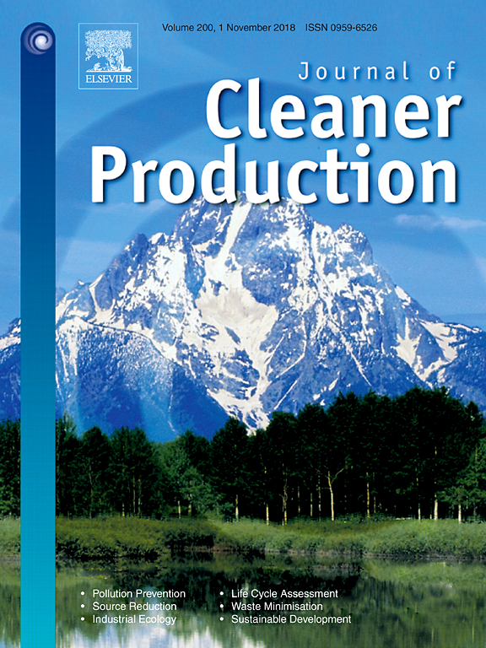
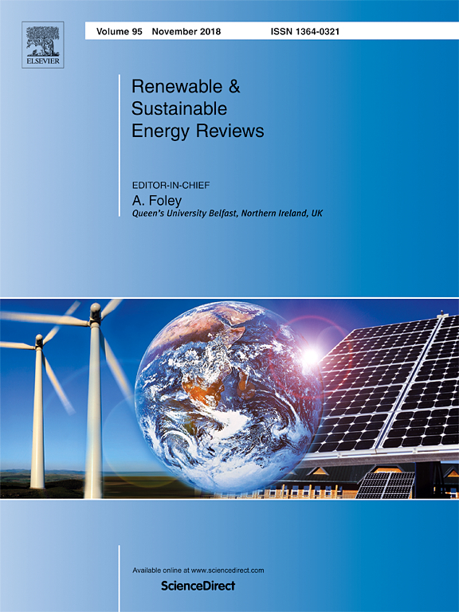
能源学优质期刊推荐
Waste Management
Waste Management is devoted to the presentation and discussion of information on solid waste generation, characterization, minimization, collection, separation, treatment and disposal, as well as manuscripts that address waste management policy, education, and economic and environmental assessments. The journal addresses various types of solid wastes including municipal (e.g., residential, institutional, commercial), agricultural and special (e.g. construction and demolition, household hazardous, sewage sludge, and non-hazardous industrial) wastes.
IF:4.723, Citescore: 4.94
Journal of Cleaner Production
The Journal of Cleaner Production is an international, transdisciplinary journal focusing on Cleaner Production, Environmental, and Sustainability research and practice. Through our published articles, we aim at helping societies become more sustainable.
'Cleaner Production' is a concept that aims at preventing the production of waste, while increasing efficiencies in the uses of energy, water, resources, and human capital.
IF:5.651, Citescore: 5.79
Renewable & Sustainable Energy Reviews
The mission of Renewable and Sustainable Energy Reviews is to communicate the most interesting and relevant critical thinking in renewable and sustainable energy in order to bring together the research community, the private sector and policy and decision makers. The aim of the journal is to share problems, solutions, novel ideas and technologies to support the transition to a low carbon future and achieve our global emissions targets as established by the United Nations Framework Convention on Climate Change.
IF:9.184, Citescore: 10.54

Slide 13













Elsevier启动了从“内容”到“内容 + 技术”的创新转换。Elsevier通过与中国科研机构的图书馆、规划办公室、研究人员以及其他相关人员的合作，我们可以为科研人员提供信息支持服务
CONTENT 内容
解决方案
Elsevier eBooks, Online Journals, Databases
Elsevier
Research Intelligence
Elsevier
R+D Solutions
Elsevier
Clinical Solutions
Elsevier
Education
PLATFORMS
Over the last
50 years the majority of Noble Laureates have published with Elsevier
Founded over
130 years ago
Employ over
7,000 employees
in 24 countries
Published over
360,000 articles
in 2014
Received over
1.1 million submissions in 2014
Work with over
30 million
Scientists, students, health & information professionals
  Over 55 million items indexed by Scopus
Notes:
OPTIONAL – For use for audiences less familiar with Elsevier
[Slide goals: introduces Elsevier as a global research collaborative, with ample data resources to build the right research at the right time, in the right place, to serve researcher needs and goals.]
So who is Elsevier?
We are is a digital information solutions company with roots in publishing world class, peer-reviewed scientific, medical, and technical literature, going back 130 years.
Our mission is to lead the way in advancing science, technology and health.
Our customers are doing momentous things and we have a responsibility to create highly effective solutions that enable our customers to leverage the vast potential of information to advance science, health and technology in ways that they could not do alone.
We also want to anticipate the new ways customers will want to use information in the future. That is what we mean by ‘leading the way’.
Our products include:
Intellectual content—largely in the form of digitized books, journals, and proprietary databases—delivering access to them via the internet and other offline digital channels (examples: journals (Lancet, imprints (Cell, MK), ScienceDirect, Mendeley, Scopus)
In addition to—and layered over—this content, are technology and analytics (tools and solutions), that allow clients and end-users to do ‘more with’ information: to produce it, interact with it, manipulate it, and share it with greater facility, efficiency, and creativity (examples: ClinicalKey, Reaxys, SciVal, SimChart)
Elsevier empowers knowledge professionals to be more collaborative and competitive, efficient and effective; to perform better, and to create knowledge with impact.

Slide 14

Elsevier 提供系列工具辅助科研及实践整体流程
研究计划
(检索，发现，阅读, 评估）
基金申请(e.g. Grants)
实验、实践（技术掌握）与分析
展示科研成果 （论文发表、专利申请、科技应用）
合作 &网络
Scopus
检索工具
核心内容
Scopus帮助工程类科研人员设计研究计划，拓展合作和网络空间，帮助基金申请
从研究计划的设立到科研成果的展示， SD全文支持贯穿科研流程始终

Slide 15
Elsevier及其出版內容
青海大学大学生态学学科科研产出分析及Elsevier相关优质出版内容推荐
Scopus + ScienceDirect平台帮助青海大大学研究人员快速定位所需内容
科研论文发表导论

Slide 16
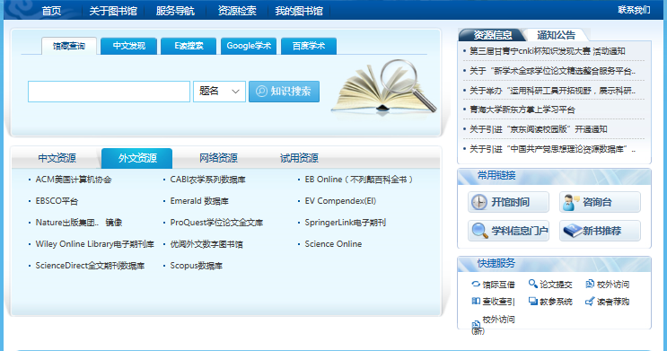
图书馆是查找科技资源的第一门户

Slide 17
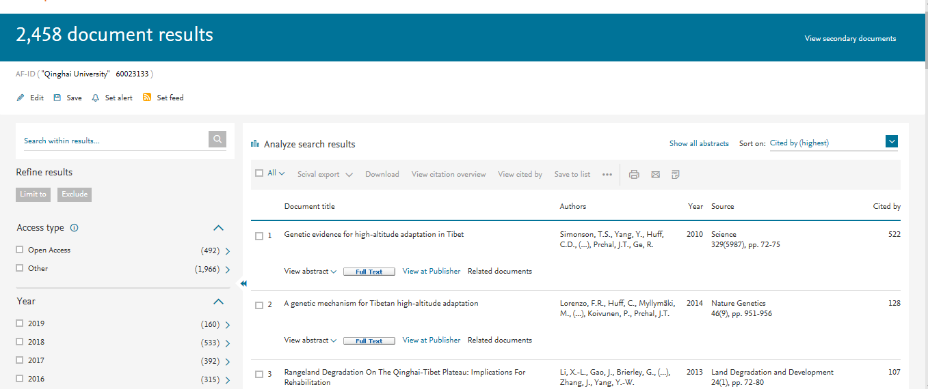
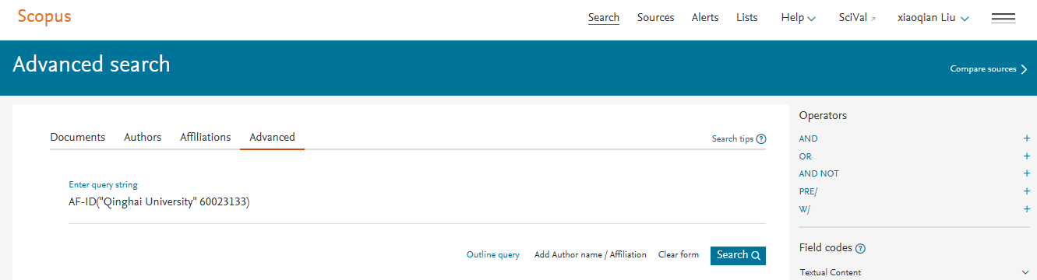
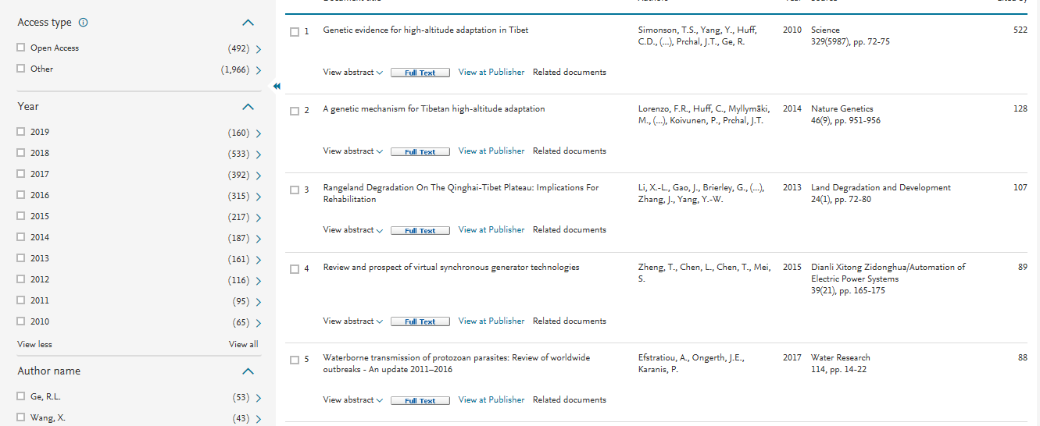
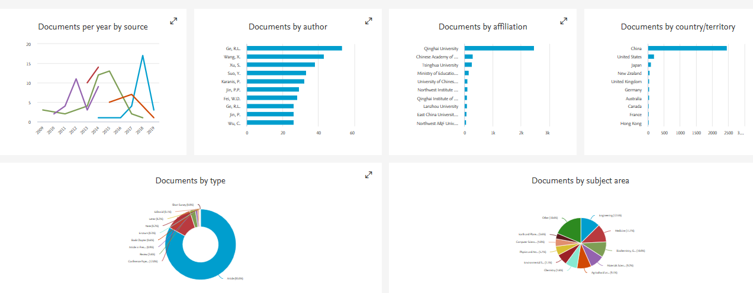

Slide 18

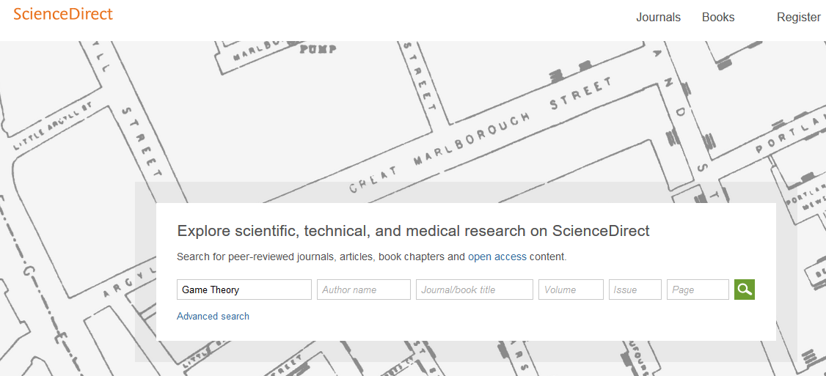
www.sciencedirect.com

Slide 19
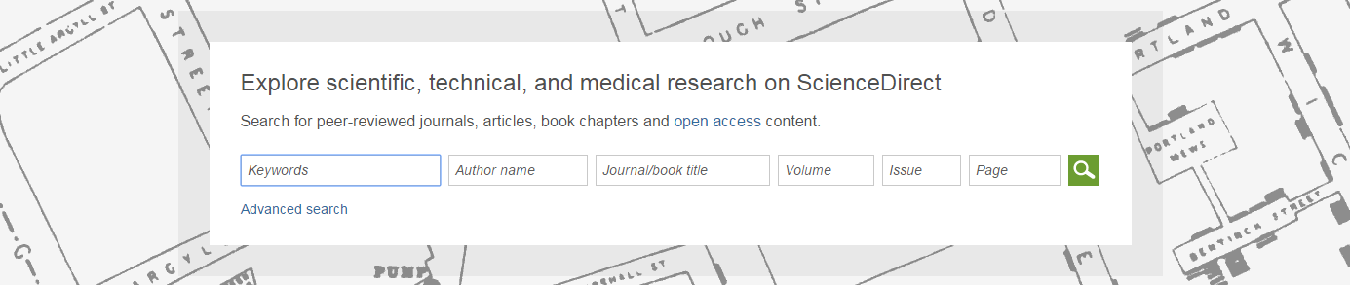
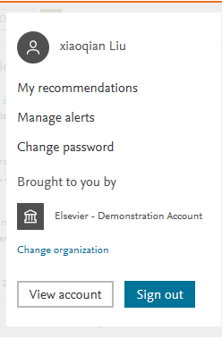
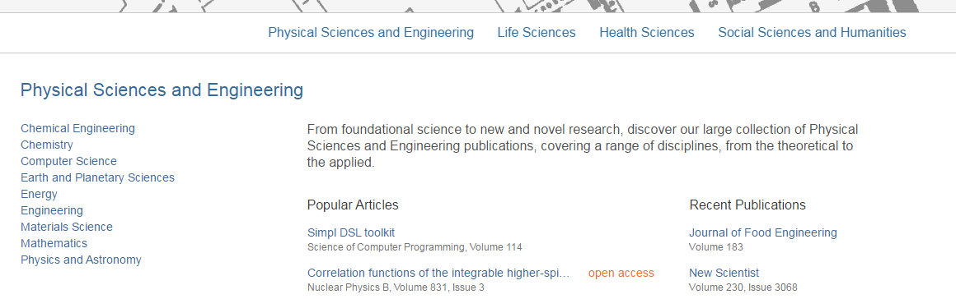
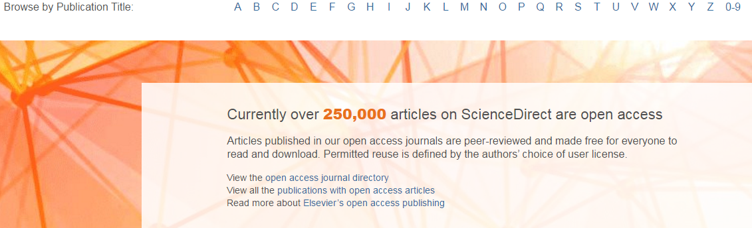
SD 主页
快速搜索及高级搜索
四大学科类型
开放获取

Slide 20
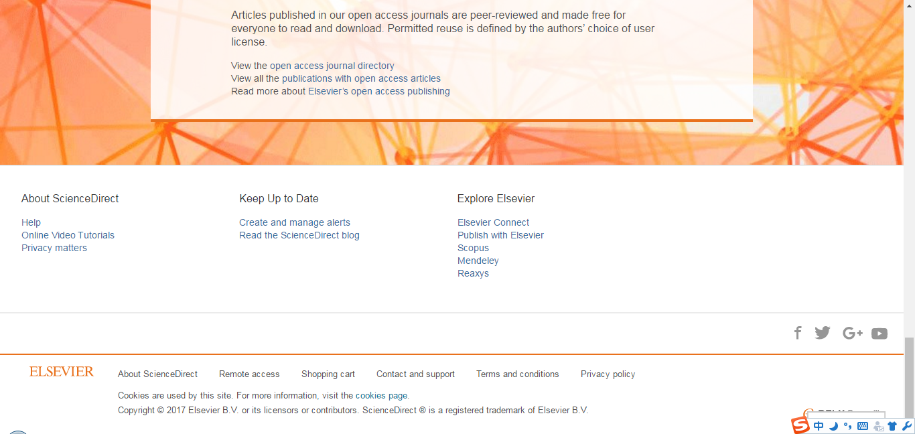
打开SD主页，用自己的用户名密码登录后，下方Activate remote access按钮
Notes:
Open the SD homepage, click on the right up button, the activate remote access button would appear.
Click the activate remote access button.

Slide 21
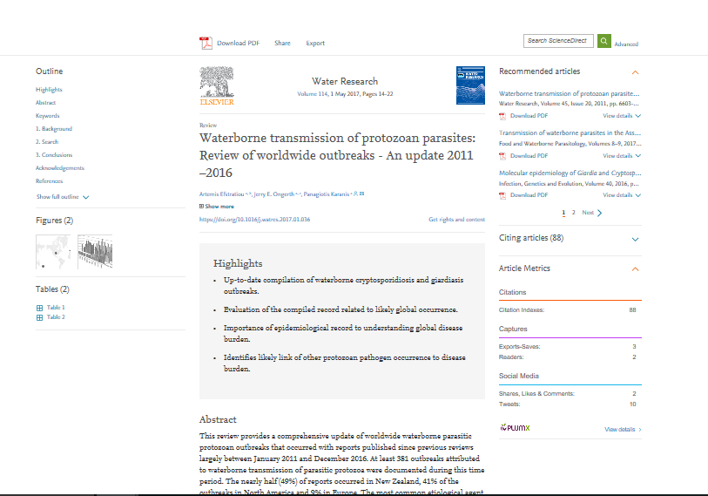
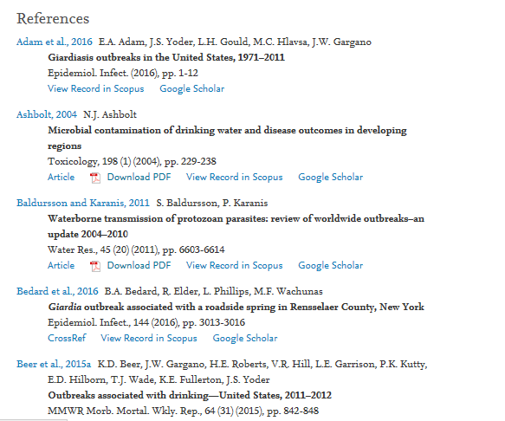
论文评价度量指标

Slide 22
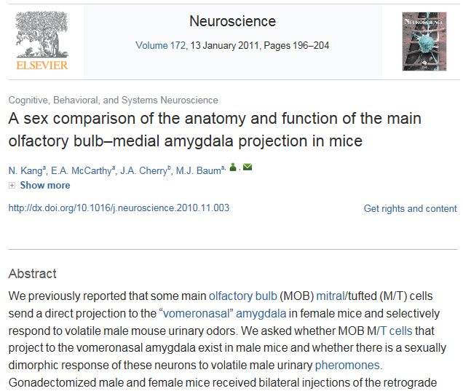
ScienceDirect主题帮助研究人员发现工作流中的关键信息
Example: think about how we understand a new or unfamiliar concepts we find in a journal article
举例：想想我们如何理解一篇期刊文章中的一个新概念或不熟悉概念
Latest Research
最新研究
Methods
方法
Fundamentals
基础
Definitions
定义
Notes:
So building on that idea we created a concept prototype that we tested with users
The prototype was centred on a common interdisciplinary use case that we had heard regular in user interviews – ‘I want to understand the journal article’
The scenario is that a researcher finds a term in an article that they are unfamiliar with – instead of providing a list of all content that relates to that concept, we signpost the content based on the problem it solves for that specific user – so latest developments, methods, fundamentals or definitions – this allows the user to more clearly navigate to the most relevant content for them
This is the basic principle we are building our solution from – a user-centric view of the content

Slide 23
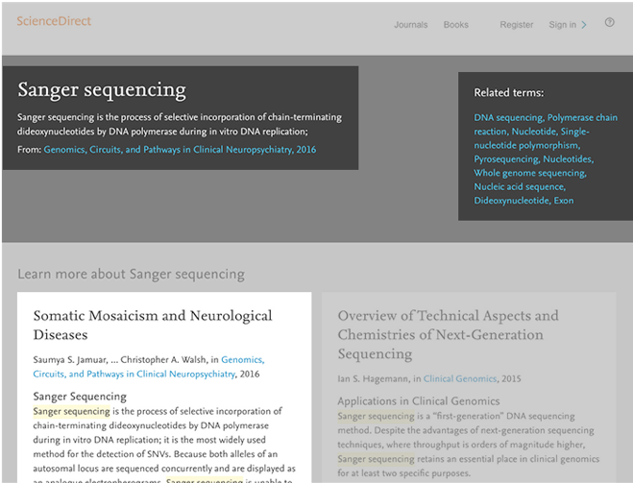
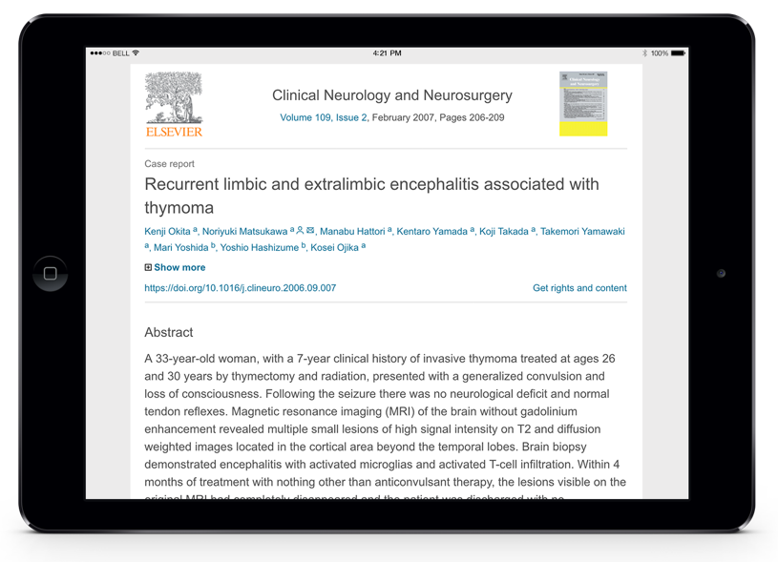

ScienceDirect主题帮助研究人员发现工作流中的关键信息
1
2
每个主题页面都提供权威的介绍性概述，帮助研究人员、学者和学生理解和解释科学文献
ScienceDirect主题页面可以在跨学科研究中快速进入新的主题领域，并为学生学习新概念或理解期刊文章提供一个简单的、交互式的工具
3
1
简短定义*
2
相关内容
3
摘自相关书籍内容
*When a short definition is not available, the longer definition can be found in Book excerpts

Slide 24
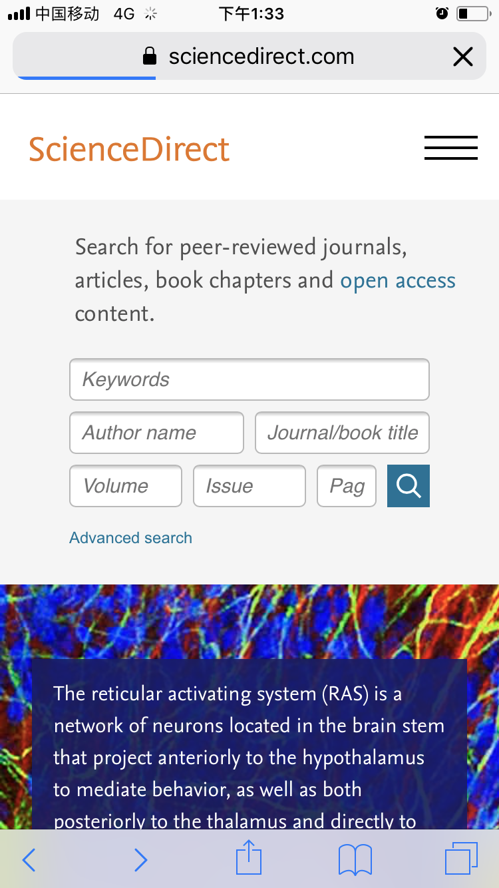
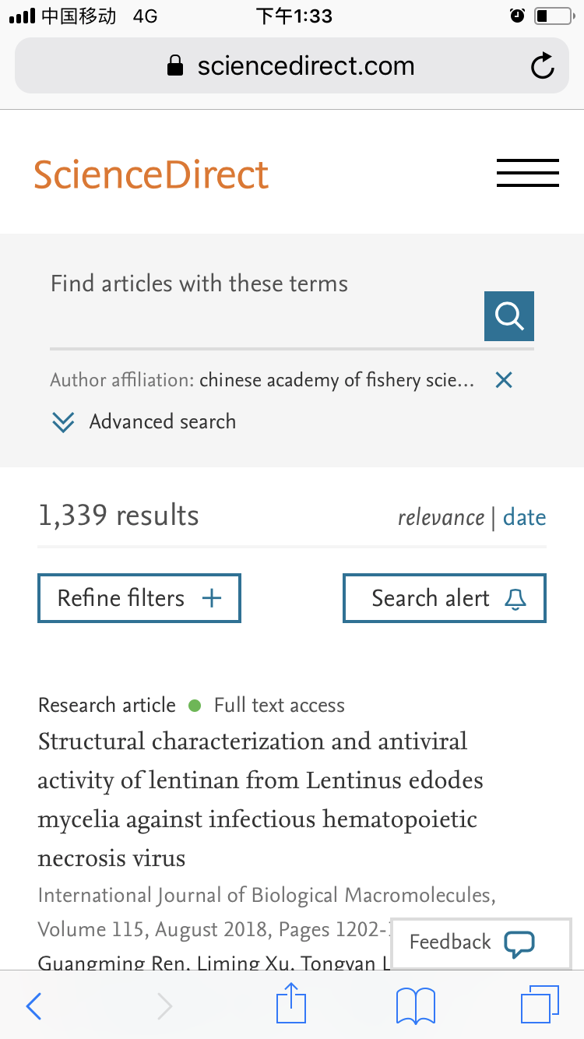
手机检索

Slide 25
Elsevier及其出版內容
青海大学大学生态学学科科研产出分析及Elsevier相关优质出版内容推荐
Scopus + ScienceDirect平台帮助青海大大学研究人员快速定位所需内容
科研论文发表导论

Slide 26
How is a journal organized?

Slide 27

How is a journal organized?
People
  Editor
  Editorial/advisory board
  Publisher
Aims and scope
Quality

Slide 28

Journal organization: Aims & Scope
A journal always has an Aims&Scope, a text that describes the goal of the journal:
  Subject
  Audience
  Type of articles
  Quality or coverage of field
  Association with group

Slide 29
Journal organization: Quality
Several indicators exist that aim to measure quality.
The indicators assume that the importance of a paper can be assessed by number of citations.
The most popular indicator, the Impact Factor, has a ‘citation window’ of two years.
CiteScore recently launched alternative
Impact Factor/CiteScore also dependent on discipline, type of articles and scope of journal

Slide 30
Journal organization: Impact Factor
Impact Factor (IF): average number of times articles from a journal published in the past two years have been cited in the current year
1339 + 1467 = 2806
All citations in 2014
to articles published in 2012 and 2013
=
=
3.456
All articles published in 2012 and 2013
350 + 462 = 812

Slide 31
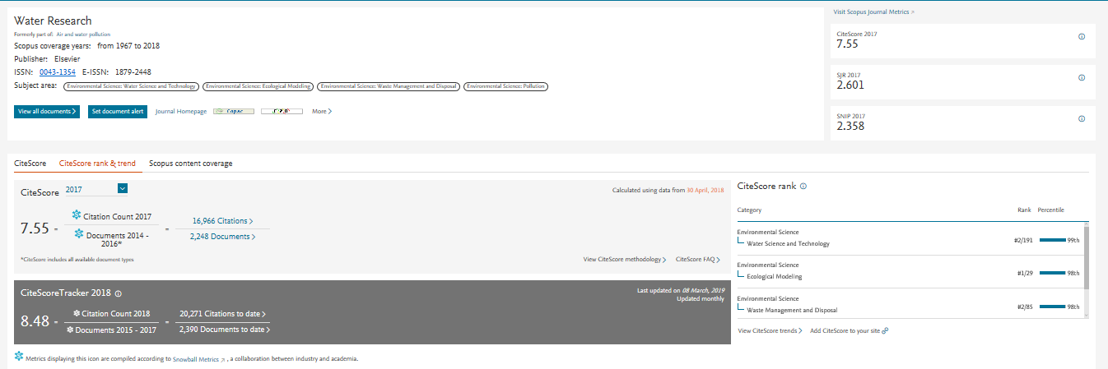
Journal organization: CiteScore
New quality indicator launched 2017.
Three year citation window
CiteScore’s numerator and denominator both include all document types
Current: develops on monthly basis

Slide 32
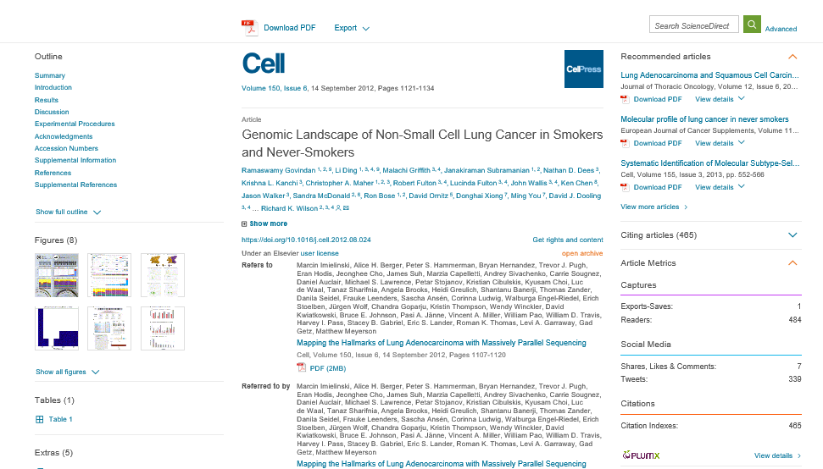
论文评价度量指标

Slide 33
Editorial process

Slide 34

Editorial process
The editorial process selects suitable articles for publication and publishes papers in one standard format.
The key step is the peer-review process

Slide 35
Peer-review process

Slide 36
Developing a manuscript

Slide 37
Think before writing ——Planning your article
Are you ready to publish?
Original results or methods
Outdated work
Duplication of published work
Significant enhancement of published work
Incorrect conclusions
Up-to-date review of a subject or field
Not ready
Work has no scientific interest
Ready
Work advances the field

Slide 38
Choosing the right journal
Best practices
Aim to reach the intended audience for your work
Choose only one journal, as simultaneous submissions are prohibited
Supervisor and colleagues can provide good suggestions
Shortlist a handful of candidate journals, and investigate them:
  Aims & Scope
  Accepted types of articles
  Readership
  Current hot topics
Articles in your reference list will usually lead you directly to the right journals.

Slide 39
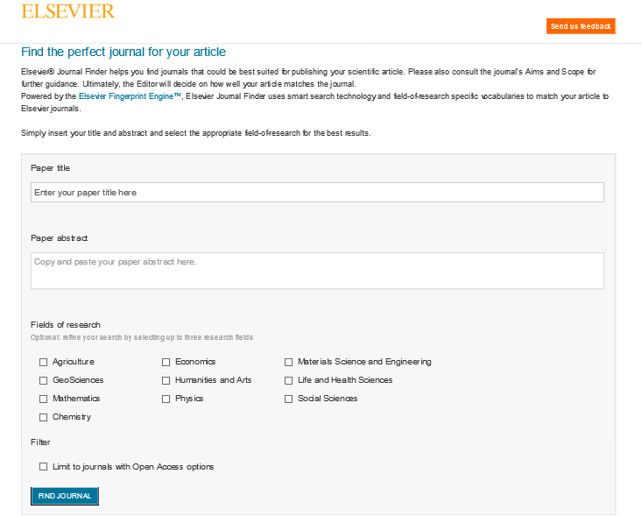
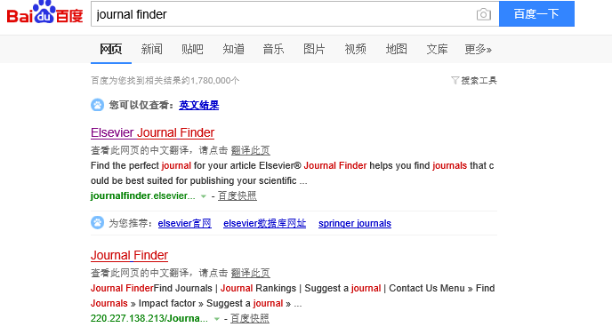
为你的科研成果找个好归宿

Slide 40
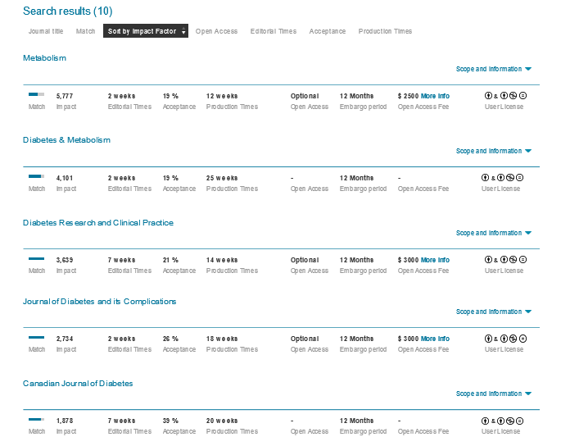
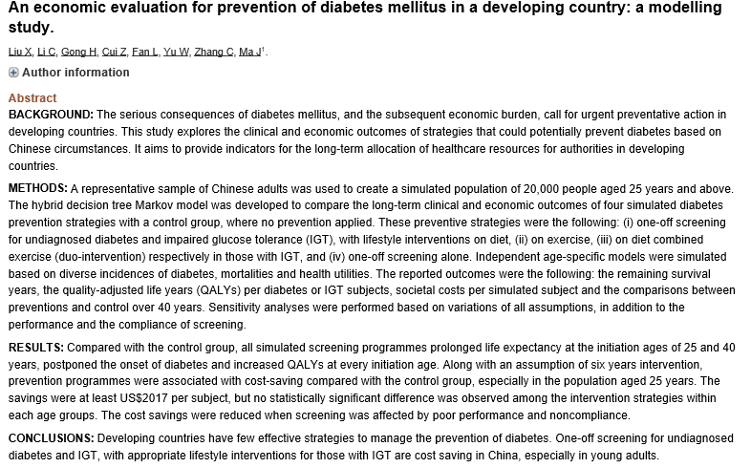
为你的科研成果找个好归宿

Slide 41


General structure of a research article
Title
Abstract
Keywords
Introduction
Methods
Results and Discussion
Conclusion
Acknowledgements
References
Supporting materials
© Reed Elsevier Group PLC

Slide 42

The process of writing – building the article
Title, Abstract, and Keywords
Conclusion
Introduction
Methods
Results
Discussion
Figures/Tables (your data)

Slide 43

Abstract
Summarize the problem, methods, results, and conclusions in a single paragraph
Make it interesting and understandable
Make it accurate and specific
  A clear abstract will strongly influence whether or not your work is considered
Keep it as brief as possible
Take the time to write the abstract very carefully. Many authors write the abstract last so that it accurately reflects the content of the paper.

Slide 44
Title
  A good title should contain the fewest possible words that adequately describe the contents of a paper
  Choose an informative, objective and business-like title.
  The titles conveys the main findings of research and is specific, concise, complete and attracts readers

Slide 45
Keywords
Keywords
  Keywords: are important for indexing: they enable your manuscript to be more easily identified and cited. Keywords should be specific. Avoid uncommon abbreviations and general terms. Check guide-for-authors for specific keyword policy.

Slide 46

References
Do not use too many references
Always ensure you have fully absorbed the material you are referencing
Avoid excessive self citations
Avoid excessive citations of publications from the same region or institute
Conform strictly to the style given in the Guide for Authors

Slide 47
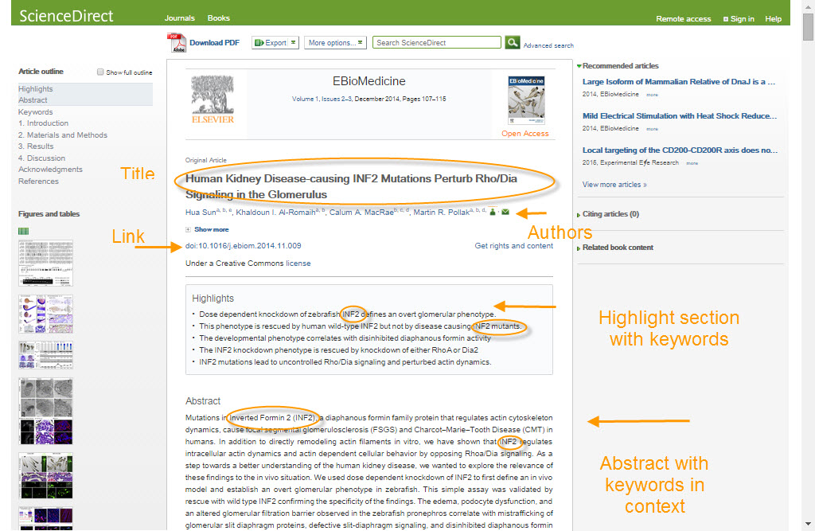
Promote your article
Search Engine Optimization (SEO)
Notes:
Search Engine Optimization, or SEO, will help your article appear higher in the results returned by search engines like Google. There are a few guidelines to help you getting higher in the search results:
Use strong keywords in your titles and headings. Think about keywords that are both descriptive and specific to this particular paper. Remember that search engines see websites differently, and pay special attention to headings and titles.
Interlink your paper with other content on the web, e.g. other papers by proper citations but also by linking your article with data repositories where relevant.
Make sure the authorship information is complete and contains the details that other researchers might use when searching for somebody
Finally, pay special attention to the captions of images and tables, including strong keywords there as well.

Slide 48
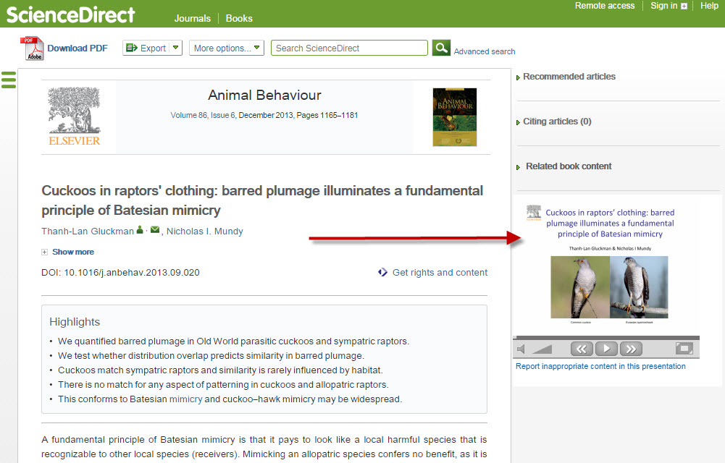
Preparing your article
AudioSlides
Notes:
AudioSlides are short, webcast-style presentations, which allow you to present your research in your own words. Elsevier offers you the option of creating your own unique AudioSlides presentation which complement your research and provides readers with a short and concise overview of the article content. These appear alongside your article once it is published on Elsevier’s ScienceDirect platform. AudioSlides are free to access and easy to share, independently from the article, with colleagues, (influential) bloggers and on social media including YouTube.

Slide 49
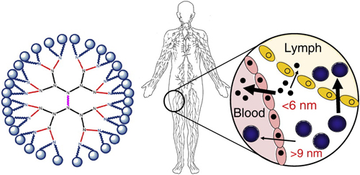
Preparing your article
Graphical Abstracts
Targeting the lymphatics using dendritic polymers (dendrimers), Lisa M. Kaminskasa, Christopher J.H. Porter, Advanced Drug Delivery Reviews, http://dx.doi.org/10.1016/j.addr.2011.05.016
Notes:
A Graphical Abstract is a visual summary of the main findings of the article that is placed as part of your article an ScienceDirect and will turn up in online search result lists. It will help people to understand the key point of your article at a glance. You can use your graphical abstract as a promotional tool by for example tweeting it, sharing it on social media or sending it to an (influential) blogger. Always add a link to your article.

Slide 50

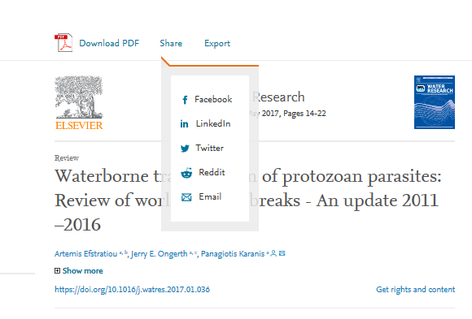
Promoting your article
1. Conferences
Prepare to network
Also connect online
Online poster
2. Media relations
Research statement
Your institution’s communication’s channels
Contact your editor or you can send an email to: researchcomm@elsevier.com
Notes:
Conferences are a great opportunity for networking and collaboration. It’s always important to:
1. Prepare your conference networking: look at the program to see who will attend and whom you’d like to meet and contact them in advance. Send them links of your published research that relate to the discussions you hope to have with them.
2. Make sure you connect with other delegates on Facebook, LinkedIn, or Mendeley. You can direct them to your website, blog or published research. At the conference itself, be prepared with business cards that include important links to where you showcase your research.
3. If you create a poster for a conference, perhaps accompanied by flyers, you can also post them on your website. And don’t forget that researchers can find it through the Poster in my Pocket app from Elsevier.
[don’t read out: Media Relations]
If you would like journalists, media outlets and the public to pick up on your published paper, it can help to have a brief statement prepared which explains the significance of your research and its key outcomes in simple language. This statement can be used as a basis for press releases, sharing on social media or other channels available to the public. Be prepared to write your own layman statement.
These days most institutions have their own press office and PR/media staff. Get in touch with them at an early stage to see what they can do to help you promote your published paper.
Elsevier also sends press releases and has different ways to highlight articles online. If you think your article is interesting for a wider audience, contact the journal editor or – immediately after acceptance – send an email researchcomm@elsevier.com to explore the possibilities.

Slide 51
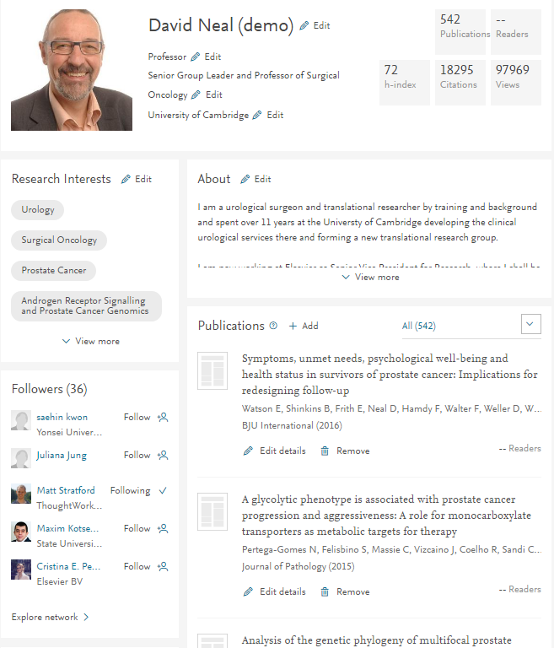

Mendeley帮助研究人员展示成果提升影响力
展示研究成果
评估影响力

Slide 52

利用ScienceDirect——Mendeley管理文献

Slide 53

利用ScienceDirect——Mendeley管理文献

Slide 54

利用ScienceDirect——Mendeley管理文献

Slide 55

利用ScienceDirect——Mendeley管理文献

Slide 56


或在Mendeley中进行文献的阅读和管理
双击加入的词条，便可自动下载，并跳转至全文阅读页面

Slide 57

Mendeley中进行文献阅读，标注和评论。以及查看文献的书目信息

Slide 58
THANK YOU

